Slide 1
MICC – Fort Benning & MICC – Fort Rucker
Ms. Dana Harris
Director, MICC – Ft. Benning
Ms. Nicole McKenzie
Director, MICC- Ft. Rucker
Acquisition Forecast Open House
Industry Day

Slide 2
WELCOME & ADMINISTRATIVE DATA
NO FOOD ALLOWED IN THE ROOM
DRINKS ALLOWED ONLY IF COVERED
QUESTIONS ALLOWED THROUGH THE PRESENTATION
SLIDES FOR THIS PRESENTATION AND A LIST OF ATTENDEES
WILL BE AVAILABLE AT THE FOLLOWING WEBSITE BY
05 JULY 19
https://www.benning.army.mil/tenant/micc/
Under the “Contractor’s Information” Tab

Slide 3
MICC Fort Benning Industry Day
19 June 2019
Agenda
0830-0900: Registration
0900-0920: Opening Remarks
MICC Fort Benning Overview
9:20 -1015: Upcoming Actions
FY20 Actions
FY21 Actions
10:15 – 10:30 BREAK
10:30 – 10:45 PTAC Representative (Bridget Bennett)
10:45 – 11:00 GSA Representative (Tray Tackling)
11:15 – 11:30 MICC Small Business Representative

Slide 4
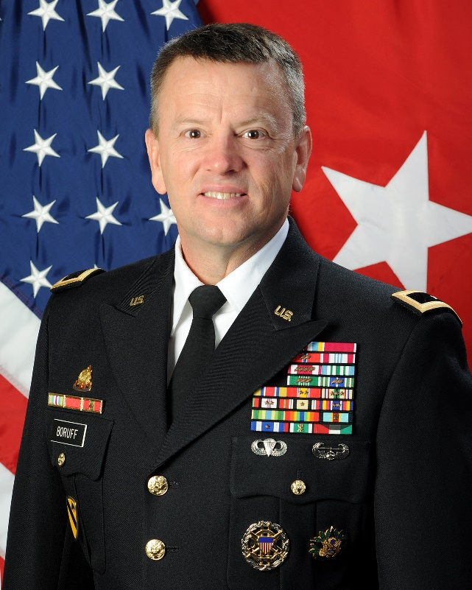
Welcome to the MICC
MISSION: The MICC provides Army commands, installations, and activities with disciplined and responsive contracting solutions and oversight. On order, aligns and provides Contracting Forces to enable Army Unified Land Operations.
VISION: We do the right thing every day and are known as the Army’s premier contracting organization.
BG William M. Boruff Commanding General
4
Notes:
“On behalf of the Mission and Installation Contracting Command Commanding General, Brigadier General William M. Boruff and the more than 1200 soldiers and civilians comprising the MICC Family, it is my pleasure to welcome you to the MICC-Fort Benning Open House. We are committed to building a ready, transparent, and accountable organization that is built on trust and respect, and this open house is a big part of that commitment.
The MICC stands committed to ensuring the promotion of early exchanges of information about future acquisitions. An early exchange of information among industry and the program manager, contracting officer, and other participants in the acquisition process can identify and resolve concerns regarding the proposed acquisition and remedy any other industry concerns or questions. We want to talk with you and hear from you, and we want to ensure that you hear from us, as early as possible in the acquisition life-cycle. That exchange is what this Open House is all about.”

Slide 5
ADVISORY
The information provided is to assist you in preparing your business plan for the upcoming fiscal years and assessing whether you may be interested in submitting an offer/bid in response to a solicitation for such a requirement.
MICC cannot guarantee that it will issue a solicitation for the exact requirement or within the same range of value for the current contract price.
Moreover, this information does not constitute sensitive source selection materials nor is it intended to provide any potential offeror/bidder any type of competitive advantage should MICC issue a solicitation for the requirement.
If you have additional questions, please contact the designated contracting officer.
This event DOES NOT take the place of requirement specific market research and industry events. It is for planning purposes only.

Slide 6
INTRODUCTIONS
Government
State your name and organization
Contractors
State your company’s name and business size and introduce yourself and participants
Extremely Brief statement of your capabilities/interest

Slide 7
MICC_FORT RUCKER
Mr. Christopher Martin
Fort Rucker
Chief, Business Operations
christopher.w.martin24.civ@mail.mil

Slide 8
FORT BENNING RECURRING REQUIREMENTS
Requirement Descriptions
Department of Public Works (DPW)
Base Operations
Washer/Dryer Lease
Paving and Grading
Grounds Maintenance
Custodial Services
Maintenance of Elevators
Pest Control
Benning Refuse
Portalet
Construction MATOC
Logistics Readiness Center
Laundry & Dry Cleaning Services
Full Food Service
Local Moves and Packing of Household Goods
Directorate of Emergency Services
Dispatch Services
Maneuver Center of Excellence
Multiple Award Task Order Contract

Slide 9
Contracting Support by CSB/FDO
GS-15
Fort Sam FDO (FSH)
418th CSB
419th CSB
GS-15
Eustis FDO
FT Belvoir
FT Meade
JBMH
AP Hill
FT Detrick
FT Sam Houston
FT Knox
DPG
FT Bliss
FT Carson
FT Hood
FT Irwin
FT Riley
JBLM
YPG
FT Polk
FT Bragg
-- HQ USARC
FT Campbell
FT Drum
FT Stewart
FT Jackson
FT Buchanan
FT McCoy
Moffett Field Div
FT Benning
FT Eustis
FT Gordon
FT Lee
FT Rucker
FT Sill
West Point
Pres. of Monterrey
FT Leavenworth
FT Leonard Wood
Carlisle Barracks
Primarily support OA22
& IMCOM HQ
Primarily support FORSCOM
and ATEC
Primarily support FORSCOM and USARC
Primarily support TRADOC
Legend:
FDO = Field Directorate Office
CSB = Contracting Support Brigade
JB = Joint Base

Slide 10
Mission Support Division
Fiscal Year 2019/20
MICC Benning Forecasted
Requirements

Slide 11
Mission Support Division
Re-compete possible (subject to availability of funding):
Wet Bulb Web Service – Martin Army Community Hospital
Grounds Maintenance - Martin Army Community Hospital
Copier Support - Martin Army Community Hospital
Translation Services – WHINSEC
Tactical Fleet Support Operators – DOTS
Solvent Tank Cleaning Service – 198th
IT LifeCycle Replacement – G-6
Copier Support

Slide 12
Mission Support Division
Re-compete possible (subject to availability of funding) for legacy MATOC task orders and new offerings:
Fort Benning, Army Futures Command or TCM (Task Area 4)
ABCT Warfighting KM/Tactical Communication
MRD Analysis and Support for BCTs
Soldier Division Capability Development
Robotics Services
Army and Maneuver Force Modernization Strategy Support
Fort Benning, MCoE (other than Task Area 4)
OSUT Instructors, new
Human Resource Support, new
WHINSEC FIRO Trainers, new

Slide 13
Mission Support Division
MCoE MATOC
TASK AREAS
Task Area 1: General Administrative, Technical, or Analytical
Task Area 2: Training Development
Task Area 3: Doctrine Development
Task Area 4: Capability Development
Task Area 5: Training Instruction Support

Slide 14
Mission Support Division
MCoE MATOC
AWARDED CONTRACTS
W911S0-19-D-0001 – Yorktown Systems Group (YSG), SDVOSB
W911S0-19-D-0002 – Summit Technologies, Inc. (STI), SDVOSB
W911S0-19-D-0003 – Cognition, LLC, SDVOSB
W911S0-19-D-0004 – Beshenich Muir & Associates, LLC (BMA), SDVOSB
W911S0-19-D-0005 – Booz Allen Hamilton (BAH)
W911S0-19-D-0006 – Janus Research Group
W911S0-19-D-0007 – Systems Studies & Simulations, Inc. (S3), WOSB

Slide 15
Mr. Rufus Gates Small Business Professional rufus.gates.civ@mail.mil
Small Business Office

Slide 16
Role of Small Business Office
UNCLASSIFIED
Implement the Army’s small business (SB) Program throughout MICC.
Serve as an advocate to maximize SB opportunities.
Advise and assist acquisition personnel on SB matters.
Conduct training to acquisition personnel
Assist in market research and acquisition strategies
Serve on Source Selection Advisory Committees & Evaluation Boards
Recommend SB set-asides
Verify accuracy and timely submission of subcontracting
plans

Slide 17
Role of Small Business Office
UNCLASSIFIED
MICC SBO has access to:
POCs – buyers, contracting officers, program managers
Forecasts for MICC needs
MICC specific processes
Local websites and postings
MICC SBO can assist with:
Counseling
Payments
Matching capabilities with requirements
Questions about contracts

Slide 18
Role of Small Business Office
UNCLASSIFIED
MICC SBO has access to:
POCs – buyers, contracting officers, program managers
Forecasts for MICC needs
MICC specific processes
Local websites and postings
MICC SBO can assist with:
Counseling
Payments
Matching capabilities with requirements
Questions about contracts

Slide 19
Pursuing Opportunities
UNCLASSIFIED
Do your homework!
Visit Federal Business Opportunities (FedBizOpps) – www.fbo.gov
Create a brief Capabilities Statement.
Respond to sources sought notices. Tell your small business competitors to respond to sources sought notices.
Team Up! See FAR 52.219-14 Limitations on Subcontracting (DEVIATION 2019-O0003) and Similarly Situated Entities.
Network and attend small business fairs and matchmaking sessions.
Explore subcontracting opportunities and establish relationships with prime contractors.
Get a Mentor. Look into Mentor-Protégé Programs.
Understand GSA Schedule requirements.

Slide 20
MICC SBO Contact Information
AMY ULISSE
Assistant Director (FDO Eustis)
Comm: (757) 878-7066
E-mail: amy.l.ulisse.civ@mail.mil
ERIC CLAUD
Small Business Professional
(Fort Eustis, Carlisle Barracks, Presidio of Monterey)
Comm: (757) 501-8119
E-mail: eric.d.claud.civ@mail.mil
TERRI BUONFIGLI
Small Business Professional
(Fort Eustis, Fort Leavenworth, Fort Sill)
Comm: (757) 501-8197
E-mail: terri.l.buonfigli.civ@mail.mil
JOYCE WILLIAMS
Small Business Professional
(Fort Eustis, Fort Lee, West Point)
Comm: (757) 501-7281
E-mail: joyce.a.williams97.civ@mail.mil
RUFUS GATES
Small Business Professional
(Fort Gordon, Fort Benning, Fort Rucker, Fort Leonard Wood)
Comm: (706) 791-1817
E-mail: rufus.gates.civ@mail.mil

Slide 21
QUESTIONS?
Notes:
[Next Slide]

Slide 22
NETWORKING
https://www.benning.army.mil/tenant/micc/
Under the “Contractor’s Information” Tab
Notes:
[Next Slide]

Slide 23
Point of Contact
Small Business Professional:
Rufus Gates
Phone #: 706-791-1817
Email: rufus.gates.civ@mail.mil

